Slide 1
The Impact of COVID-19 on the Demographic Dividend Pillars in Africa
Bernard Onyango, PhD.
Senior Research and Policy Analyst, AFIDEP
November 11, 2020

Slide 2
What is the Demographic Dividend (DD)?
It is the economic benefit arising from a significant increase in the ratio of working-age adults relative to young dependents.
When birth rates decline significantly, the age structure shifts in favor of more working-age adults, which can help accelerate economic growth through increased productivity, greater household savings, and lower costs for basic social services provided to children
The DD is not guaranteed by the shift in age structure alone but must be accompanied by investments in human capital development (health; education and skills) and promoting an enabling environment that provides opportunities for decent jobs

Slide 3
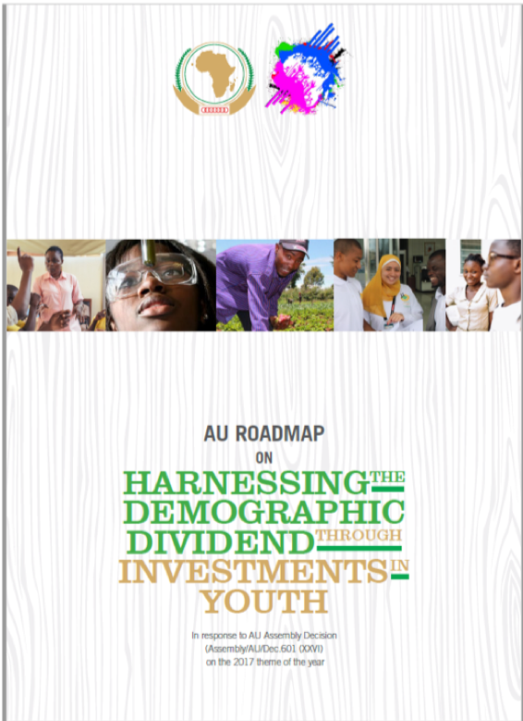
The African Union’s Pillars of the Demographic Dividend
Source: AUC 2017

Slide 4
COVID-19 Impact on the DD
Both emergency and long-term impact on
Health and wellbeing
Education
Employment and livelihoods
These will have a bearing on the DD in Africa and we need to understand the potential impact in order to mitigate negative effects on the potential to harness the DD in Africa.

Slide 5
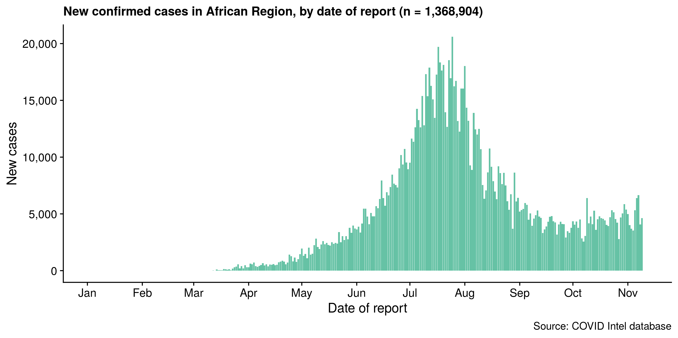
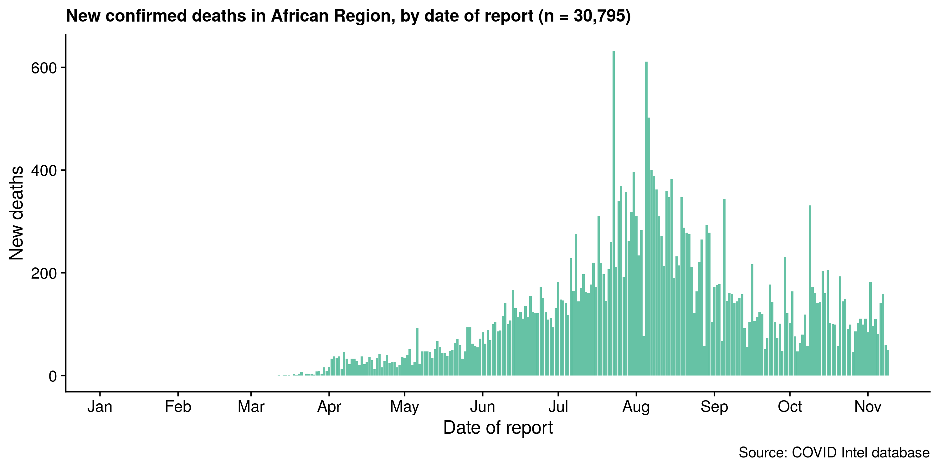
Africa has accounted for a small proportion of the COVID-19 cases and deaths
Africa accounts for 2.7% of all confirmed cases and 2.4% of all confirmed deaths to date (WHO)
Notes:
While it was initially feared that Africa could suffer the brunt of the immediate impact of COVID-19 because of factors such as weak health systems, high levels of poverty and crowding in urban areas, the region has so far had a relatively small proportion of the population affected, accounting for 2.7 percent of the more than 50 million confirmed cases to date and 2.4 percent of the more than 1.2 million confirmed deaths globally. However, we are not out of the woods yet and we are seeing some countries such as Kenya, Algeria and Uganda experiencing what could be a second wave of the pandemic in recent weeks.

Slide 6
Implications for Health and Wellbeing
Short-term disruptions in the health sector services have included negative impact on family planning and sexual and reproductive services
Suspension of vaccination campaigns
Diversion of resources for other critical healthcare needs to COVID-19
Reports in a rise in Gender-based violence, unintended and teenage pregnancies
Long-term health consequences still unknown but various areas could be affected including sexual and reproductive health, mental health and nutrition

Slide 7
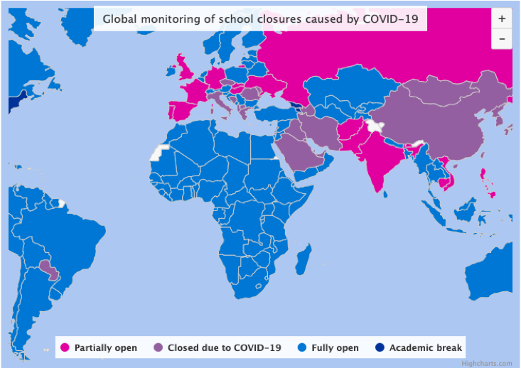
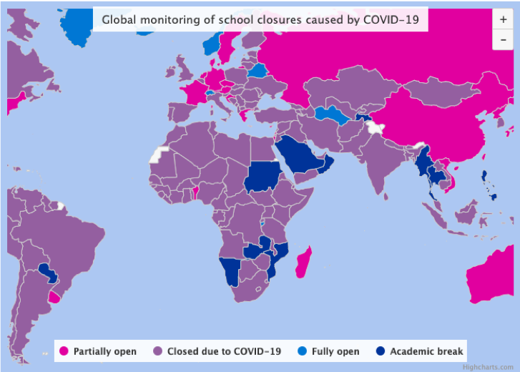
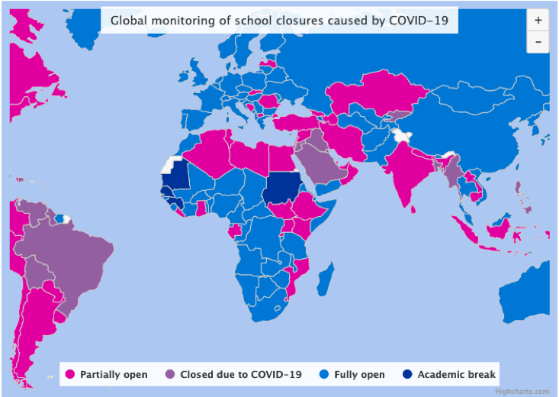
Education and training has been massively disrupted
March 10, 2020
May 10, 2020
November 10, 2020
Source: UNESCO

Slide 8
Implications for Education and Training
Learning disrupted and education years lost
Drop-outs
UNESCO estimates that about 5.3million learners in sub Saharan Africa (from pre-primary to university level), are at risk of not returning to school in 2020
Child marriages and teen pregnancies
Rising inequality

Slide 9
Mitigation strategies
Challenges
Continuity of learning strategies including:
Online learning including the use of teleconferencing platforms
Delivery of curriculum through radio and television
Partial re-opening of schools
Lack of inclusion - poor and rural communities were unable to access alternative platforms to in-person training
Females disadvantaged by digital learning
Curricula and teacher training not designed for effective delivery on alternative platforms

Slide 10
Eat or Heal
Economy or Health

Slide 11
Strict lockdown and other restrictions severely affect livelihoods
Massive job losses and reduced income especially in the informal sectors and urban areas
For most countries, exposed a lack of formal social safety nets to support families
Urban to rural migration as a coping strategy
Recovery will take long and the World Bank is projecting a recession for the region
Re-allocation of resources for emergency needs and borrowing will limit fiscal space for investments in critical social sectors

Slide 12
1.1% growth rate in 2020 in the best case scenario and a contraction of -2.6 percent in the worst case scenario.
19 million people deprived of their livelihoods
29 million people pushed into poverty in the context of weak social protection programmes
UN Economic Commission of Africa, May 2020

Slide 13
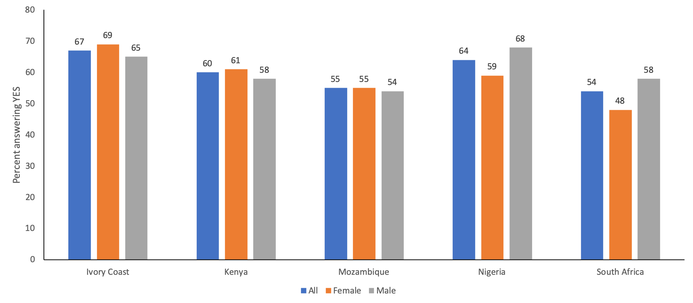
GeoPoll Study: Has the current COVID-19 impact stopped you from being able to work?
Source: GeoPoll Study on the Financial Impact of Coronavirus in Sub-Saharan Africa

Slide 14
GeoPoll Study: Have you received any form of aid since the COVID-19 crisis started?
Source: GeoPoll Study on the Financial Impact of Coronavirus in Sub-Saharan Africa

Slide 15
GeoPoll Study: Received aid from government
Source: GeoPoll Study on the Financial Impact of Coronavirus in Sub-Saharan Africa

Slide 16
Data and measurement
Lack of data
Has undermined response e.g. targeting of emergency support and cash transfers to the vulnerable
Implications for measuring long term impact
Disruption of routine and periodic data to inform health and socio-economic sectors (e.g. DHS, Census)
Innovations and adopting new approaches (e.g. SMS surveys, telephone interviews and other forms of digital surveys)

Slide 17
Conclusion
The pandemic is still evolving in Africa.
Already, evidence of the negative impact on the potential to harness the demographic dividend in Africa has emerged.
Quantifying this impact will be an ongoing process.
Critically important to put in mitigation measures now.

Slide 18
Thank You!

