Slide 1
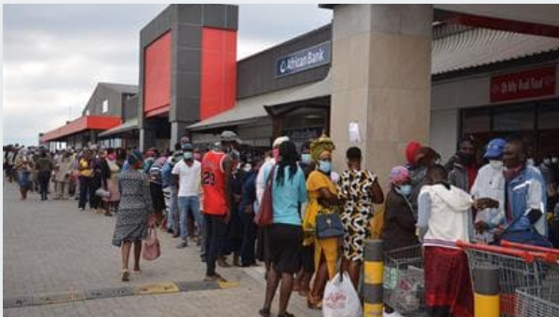
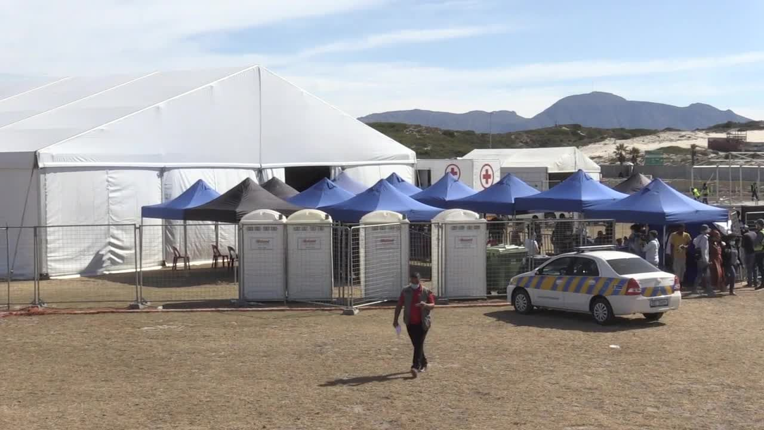

Social Protection during COVID-19 in South Africa

Slide 2

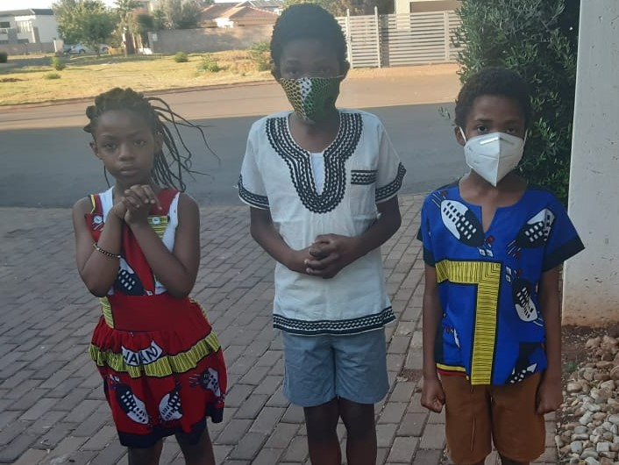

The Constitution; the National Development Plan & Social Protection
NDP 2012: The NDP envisages that, by 2030, there is a defined social floor that provides a diversity of guarantees to citizens, and is also sustainable. There must be basic social protection guarantees aimed at preventing or alleviating poverty and protecting against vulnerability - accessible and available to those who need them most; responsive to the needs and realities of those who the system is intended to benefit; be based on a principle of building and utilising the capabilities of individuals, households and communities and avoiding the creation of dependency and stigma; and be flexible and capable of responding to rapidly changing scenarios and the changing needs of individuals across the life cycle.
Section 27 (1) (c) of the Constitution provides for the right of access to appropriate social assistance to those unable support themselves and their dependants.
Section 28 (1) of the Constitution sets out the rights of children with regard to appropriate care (basic nutrition, shelter, health care services and social services) and detention.
Schedule 4 of the Constitution further identifies welfare services, population development and disaster management as functional areas of concurrent national and provincial legislative competence.
Bill of rights: right to have access to adequate housing; health care services, including reproductive health care; sufficient food and water; basic education

Slide 3
Before the Advent of Covid 19
Poverty in SA was (still is) predominantly Black, female, and its manifestation most severe in former homelands - former homelands are home to 28% of the population, yet harboured about 40% of the poor households. Using the US$1.25 PPP per day poverty reference line, South Africa’s social cash transfers reduce extreme poverty very significantly. The incidence of extreme poverty reduces by 68 per cent (from 26 per cent to 8 per cent) after accounting for social transfers.
  Government spending on social grants as part of the poverty reduction strategy, had been on the rise as well; from R57 Billion (in 2006/2007) to R162 billion in 2018/19. Numbers rising: From 2.4 million in 1996 to 17.6 million in 2018, to 18.3 in 2020 (12 million of whom are CSG recipients).
Inequality: Fiscal policy reduced Gini coefficient from 0.771 to a “disposable income” Gini of 0.694 once direct taxes and transfers (cash transfer and free basic services) are taken into account. When account is taken of monetary expenditures and investment into health and education, the Gini coefficient declines further to 0.596.
Improved access and quality: ECD - About 800 654 children access registered ECD programmes and of this figure, about 624 000 receive an ECD subsidy of about R17 per child per day for 264 days, basic education – STEM, quality of passes, infrastructure; Health MTSF - 75% of South Africans should be covered by NHI by 2024, which should increase to 90% of the population by 2030; reduction in IMR; MMR etc.
Universal access to quality basic services
Improved efficiency and coverage social assistance and social insurance – e.g. UIF efficiency improving but covers only 5% of the unemployed,
Optimising Social Welfare policy Space: Partnerships and Financing models for NGOs/CBOs, White paper on Social Welfare; hiring of additional social workers, articulation of developmental social welfare and minimum social floor being finalized; Children’s Act Ammendment; NSP, Victim Support Services Bill etc.
On the economic front, COVID-19 happened at a time when the pace of global economic activity remained weak; the unemployment crisis had deepened, with rate at a ten-year record high of 29.1% in the last quarter of 2019, Youth unemployment worsened to 58.1% compared to the corresponding period in 2018.

Slide 4
COVID 19 impact and interventions
166 Shelters for the homeless were created and the homeless were moved to these hastily created shelters: Tshwane, Cape Town and Durban. - Services to be provided in the shelters included Dignity packs, food – 3x/day, shelter, sanitisers, mattresses, blankets, PPEs, COVID19 awareness training, screening for substance abuse and psychosocial support. The intention was also to develop Personal Development Plan (PDP) for each
Institutions such as old age homes also under lockdown to protect residents
PSET, Schools closed: 9 million learners who receive a meal through the National School Nutrition Programme (NSNP) will not get food - initially. On line learning for those who had access, but not very effective:
Response
  curriculum pruned, exams moved to later, social distancing – shifts/platooning
  Infrastructure grant used to ready schools for COVID19 – water and sanitation, PPEs and sanitisers will impact negatively replacement of inappropriate schools as per the school infrastructure norms
  NSFAS continued to be paid, data packages and lap tops availed to enable on line learning; Learning sites zero rated
  MTSF goals still pertain e.g. All special schools have access to required therapists by 2024; Coding and Robotics curriculum to be in place by 2021 and implemented by 2024 BUT Access, quality and Missing middle in the context of reduced revenue from government??????
Movement including that of children curtailed
Reports on GBVF and other crimes reduced. (could be due to lockdown and unavailability of alcohol)
Lockdown meant people’s livelihoods will be disrupted particularly those that work in the informal sector

Slide 5
COVID 19 interventions (2)
Investment in Health Infrastructure in preparation for COVID19 onslaught – lockdown, screening, testing, tracing as @ 25 October with only 318 Covid-19 deaths per million population, as at 25 October 2020, South Africa has the third lowest mortality rate after India (88 per million); the Russian Federation (178 per million)
  Mask, sanitizing, washing of hands, social distancing
Renewed focus on key child health indicators, including immunization coverage; and child mortality from diarrhoea; pneumonia and severe acute malnutrition, is required.
GBVF space also declared essential work, referral pathways articulated; NSP implemented – monitored at highest level
18 653 water tanks and 1 315 tankers provided as part of the Covid-19 response providing much needed services to communities without access to potable water: Challenges: Shutdown of construction activity during lockdown affected targets for housing provision, eradication of bucket sanitation and upgrading of informal settlements; job losses impacted negatively on ability to pay for services and thus “cross subsidisation for free basic services”.
SASSA staggered payments of grants to reduce payment lines: beneficiaries (i.e. the elderly and people with disabilities) collectively amount to about 4 million beneficiaries. For the payment of the April social grants, the money was released earlier for payment. E.g. on 30 & 31 March for only the elderly and persons with disability. The remainder of other beneficiaries were paid from 01 April 2020.
Coordinating structures created for agile and swift response – natjoints, provjoints, war-rooms, etc.
Additional community workers hired for testing, education, social work practitioners including social workers hired for psycho social support
Reports on GBVF and other crimes reduced. (could be due to lockdown and unavailability of alcohol)
Lockdown meant people’s livelihoods will be disrupted particularly those that work in the informal sector

Slide 6
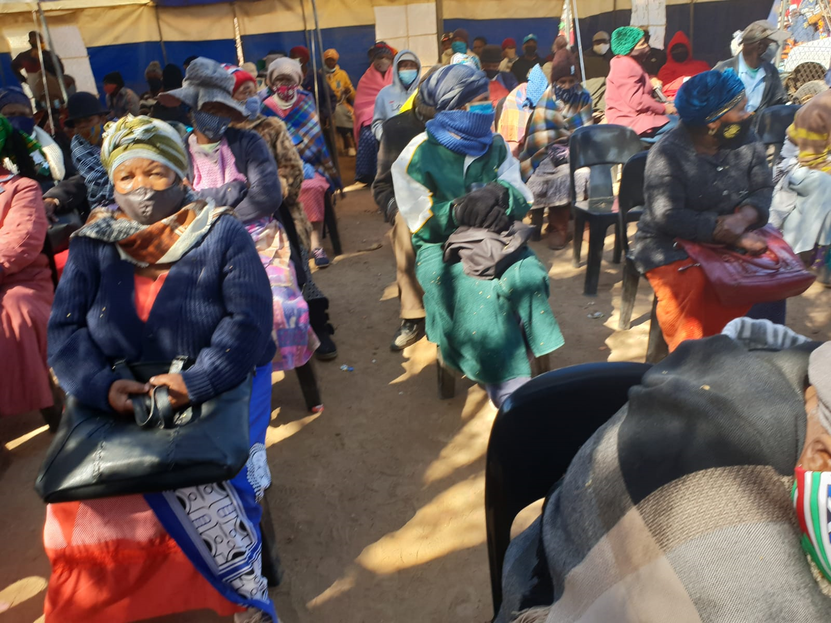
Social Assistance COVID-19 in South Africa

Slide 7
Covid 19 Response – Social Security
  Social Assistance:
    There was a once-off CSG increase of R300 per child in May 2020; existing grants topped by R250 from May to October 2020, From June Care-givers were paid R500 up to October 2020,
    3.9 million unemployed people have been paid Social Relief of Distress grant of R350 now up to January 2021
    As at August 30, about 3,788,215 South Africans and 1867 permit holders (foreign nationals) were in receipt of the Special COVID-19 SRD grant. Excluding COVID-19 special grant, there SASSA pays social grants to about 18.3 million, received by about 11.3 million recipients.
    The monthly expenditure of the grants is about R16 billion and now adjusted to about R20 billion due to the COVID-19 social relief
    Beneficiaries of the temporary disability grant whose grants have expired during the lockdown period have had their grants continued through a ministerial directive.
    Furthermore, grants that are not collected for three consecutive months do not lapse as originally prescribed in the Social Assistance Regulations
  Social Insurance: UIF COVID-19 TERS:
    Over 960 000 employers were paid R49.2 Billion COVID-19 TERS on behalf of 11 Million employees. The UI Act had been amended to extend the length of period for which claimants can receive the benefit; from a maximum period of six months to a new maximum of 12.

Slide 8
Covid 19 Response – Social Grants and COVID19 SRD grant
NUMBER OF SOCIAL GRANTS PLUS COVID 19 PER PROVINCE
Prov. | Population Est. | Social Grants as at July 2020 | Covid -19 SRD Grant | Grants as a % of the total population
Eastern Cape | 6,712,276 | 2,835,249 | 740,590 | 53%
Free State | 2,887,465 | 1,042,344 | 296,877 | 46%
Gauteng | 15,176,116 | 2,814,767 | 1,187,226 | 26%
KwaZulu-Natal | 11,289,086 | 4,072,116 | 1,244,673 | 47%
Limpopo | 5,982,584 | 2,620,628 | 776,584 | 57%
Mpumalanga | 4,592,187 | 1,549,661 | 470,537 | 44%
North West | 4,027,160 | 1,285,198 | 382,917 | 41%
Northern Cape | 1,263,875 | 498,929 | 107,728 | 48%
Western Cape | 6,844,272 | 1,651,085 | 369,891 | 30%
South Africa | 58,775,022 | 18,369,977 | 5,577,023 | 41%

Slide 9
Covid 19 Response – Social Grants and COVID19 SRD grant

Slide 10
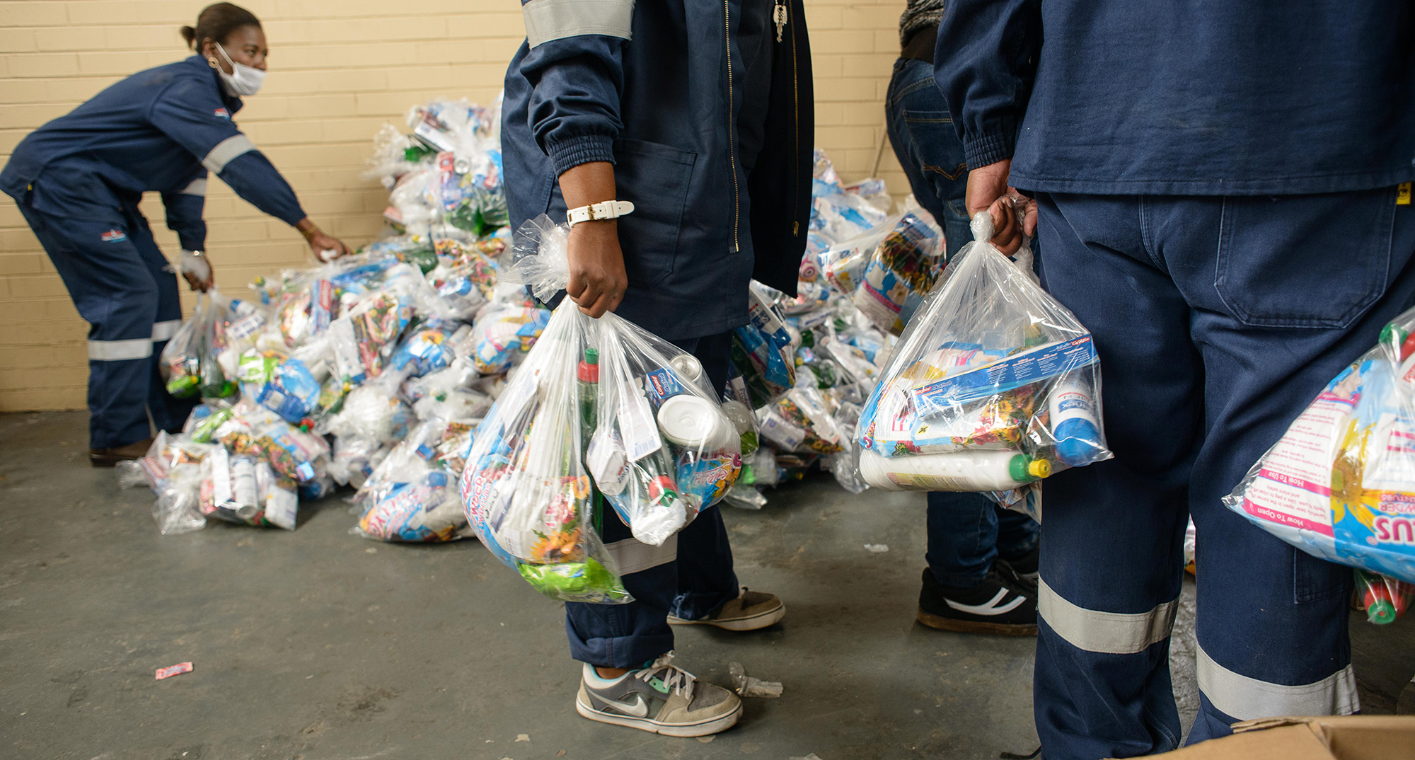
Covid 19 Response 2 – Food parcel distribution
DEPARTMENT /ENTITITY | FOOD PARCELS DISTRIBUTED | Estimated number of people reached (1:5)
Department of Environment, Forestry and Fisheries | 1 500 | 7 500
Solidarity fund through big four NPOs operating in all nine Provinces | 220 674 | 1 103 370
DSD total | 999 047 | 4 995 235
SASSA SRD | 105 000 | 525 000
Old Mutual | 7 740 | 38 700
GRAND TOTAL FOOD PARCELS | 1 333 961 | 6 669 805

Slide 11
Context
What is the problem?
Rising levels of hunger, poverty which are further exacerbated by the COVID-19 pandemic and lock-down.
How big is the problem?
23.8% of the population (14 million people) who are food insecure (experience hunger) prior to COVID-19 pandemic.
Current Provision
Only 5 188 245 (37%) people access food through Government and other partners support as part of COVID-19 response
Gap analysis:
14 million – 5.2 million = 8,8 million (63%) of food insecure and vulnerable people have not been reached
Provinces indicated they need R868 million to support a further 1.5 million people in the next three months
Impact of COVID 19 on the problem:
StatsSA projected that 50% of the population is at risk of being food insecure
28.5 million (current provision against this is 18%)

Slide 12
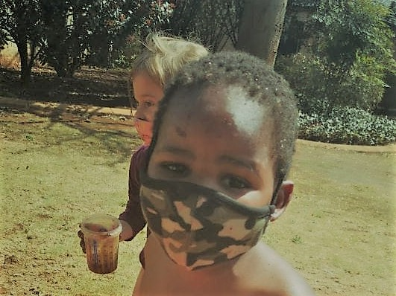


Covid 19 Response 3 - ECD
ECD: were shut (About 800 654 children access registered ECD programmes and of this figure, about 624 000 receive an ECD subsidy of about R17 per child per day for 264 days;) .
Current Status:
  21 217 registered ECD centres and 28 384 unregistered.
  Online and manual forms have been sent to stakeholders on 23/06/2020 and are completed on a daily basis. As at 08/09/2020 we had 15 668 completed online assessment forms; 13 489: manual.
  Total Assessments: 29 157 (Provinces have established teams at provincial, district and local level to facilitate the process); About 10 729 centres require support; 10,000 centres opened and 65,000 children are back at ECD
ECD: A survey showed that 83% of operators have not been able to pay full salaries of staff over the lockdown period, 96% not able to cover their full operating costs, 68% were worried that they would not be able to reopen 35%,

Slide 13
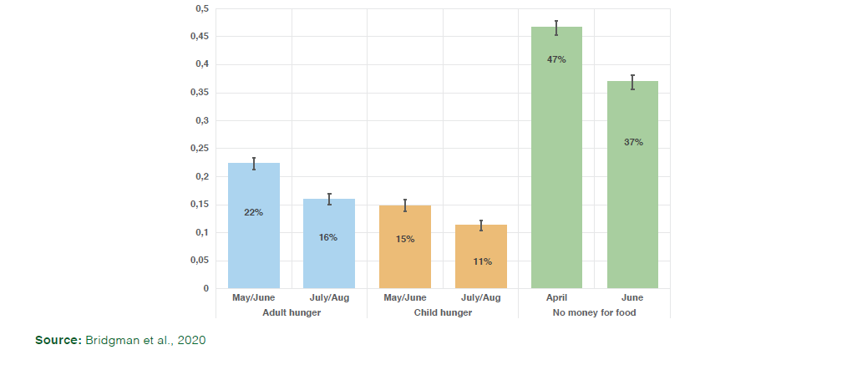
Covid 19 Response - Impact
Impact:
2.2 million (STATSSA)to 3 million (NIDS CRAM) jobs lost as a consequence of the lock down; Wave 2 data NIDS CRAM show that that number of unemployed has not changed even with easing of lockdown. STATSSA LFS - expanded definition of employment increasing from 39.7% to 42%; Workers who were poor, rural, female, unskilled and less educated have experienced the largest declines in employment; Informal workers faced twice the employment loss of formal workers; The evidence suggests that millions of people will remain unemployed for an extended period of time beyond October 2020 BUT Reported rates of hunger have declined from May to August by approximately 27%. This correlates with the rollout of governments relief package

Slide 14
Covid 19 Response - Impact and lessons learnt
Lessons learnt:
Guidelines necessary for food distribution e.g. cooked food or parcels must be distributed to households through knock and drop; Organisation or the person must adhere to all food handling standards; All food or food parcels must meet the required minimum health standards; The cooked food or food parcel must contain items of high nutritional value; and Preferably food parcels contain food with a long shelf life; Any person who is distributing food or food parcels must inform local SAPS Police Station of their intention to so do prior to the delivery of food or food parcels
For Demographic Dividend:
  Develop a framework and guide on the provision of integrated services for homeless people;
  Prioritise ECD – quality and access;
  Improve governance for all social security systems;
  Increase compliment of social workers and social work practitioners;
  Articulate social protection floor, Innovatively fund quality and access of social wage and Implement a single register for the social wage;
  Innovatively fund PSET – quality, access, responsiveness;
  Implement NHI and ensure universal coverage;
  Implement economic recovery plan

Slide 15
THANK YOU

