Slide 1



An Exploration of Evidence-based Service Delivery in the Times of COVID-19
Evidence on the impact of COVID-19 on service delivery from Health and Demographic Surveillance Sites (HDSS)
Kobus Herbst^{1,2}, Guy Harling, Chodziwadziwa Kabudula, Mark Siedner, Xavier Gomez-Olive, Urisha Singh, Dickman Gareta, Daniel Ohene-Kwofie, Rose Buckland, Tinofa Mutevedzi, Kathleen Kahn, Mark Collinson, Eric Maimela, Steve Tollman
¹ Director : DSI-SAMRC South African Population Research Infrastructure
² Faculty : Africa Health Research Institute

Slide 2

SAPRIN
Covid-19 Surveillance
Part of Research Infrastructure Roadmap (SARIR)
Population Platform to:
  Provide multi-disciplinary research evidence
  Inform health and social policy and programming
Poor rural and urban communities
Each node follow at least 100 000 individuals in
20 000 households
Routine Surveillance
15 week cycle
DIMAMO, Peri-urban
20 000 households
20 000 households
20 000 households
Agincourt, Rural
High Intensity Sample
GRT-INSPIRED, Urban
2 week cycle
750+ households
AHRI, Rural
Siedner, Harling, Herbst et al; Wellcome Open, doi: 10.12688/wellcomeopenres.15949.1
eThekwini, Urban
Eastern Cape, Rural
C-SHARP, Urban
Established Under development Planned
Notes:
SAPRIN is part of the Dept of Science and Innovation’s Research Infrastructure Roadmap and provides an unique national resource and research platform to strengthen evidence and inform health and social policy and programming at a time when we are reeling from the impact of the Covid-19 pandemic.
Each SAPRIN node regularly collects population, health and socio-economic data from a geographically defined complete population of at least 100 000 persons in impoverished and developmentally constrained communities both urban and rural. The data that I will present here are from the three established rural nodes in Mpumalanga, Limpopo and KwaZulu-Natal. Two urban nodes are currently under development in Gauteng and the Western Cape. We hope to add a further two nodes in eThekwini and the Eastern Cape.

Slide 3
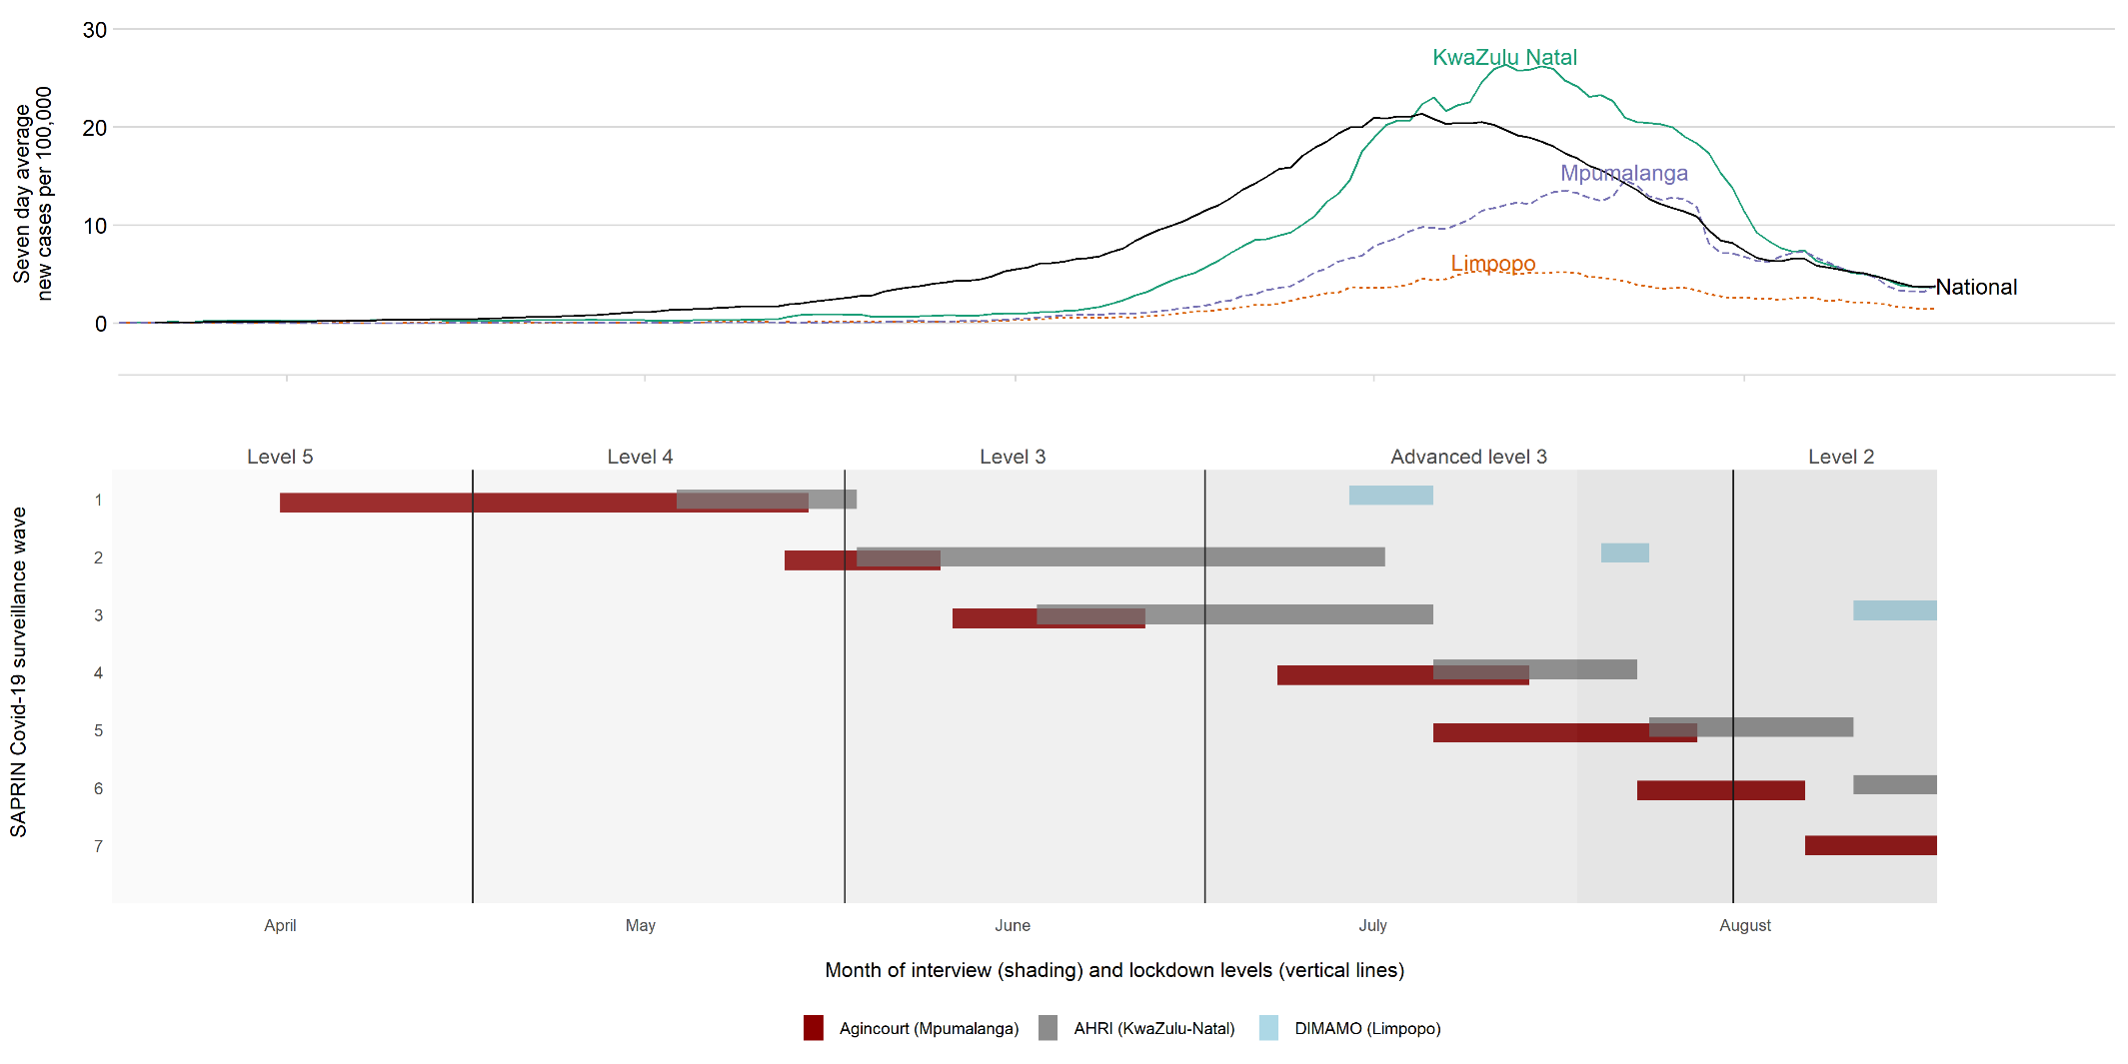
Covid-19 Surveillance Progress

Slide 4
Covid-19 Surveillance Population
Summary Information | Agincourt | DIMAMO | AHRI | Total
Total number of household interviews (count the multiple times a household was interviewed in high intensity) | 16,892 | 8,347 | 22,491 | 47,730
Total number of unique households eligible to be interviewed | 13,169 | 13,873 | 20,151 | 47,193
Total number of unique households interviewed | 10,589 | 5,154 | 17,110 | 17,454
Total number of individual telephonic screenings (some individuals will have been screened multiple times) | 102,509 | 33,310 | 91,184 | 227,003
Total number of unique individuals screened. | 62,306 | 21,633 | 64,821 | 148,760
Number of individuals screening as possible suspect Covid-19 cases | 261 (0.4%) | 184 (0.9%) | 680 (1%) | 1,125 (0.8%)
Number of individuals tested for Covid-19 | 6 | 184 | 393 | 583
Number of individuals testing positive for Covid-19. | 0 | 12 (6.5%) | 52 (13.3%) | 64 (11,0%)

Slide 5
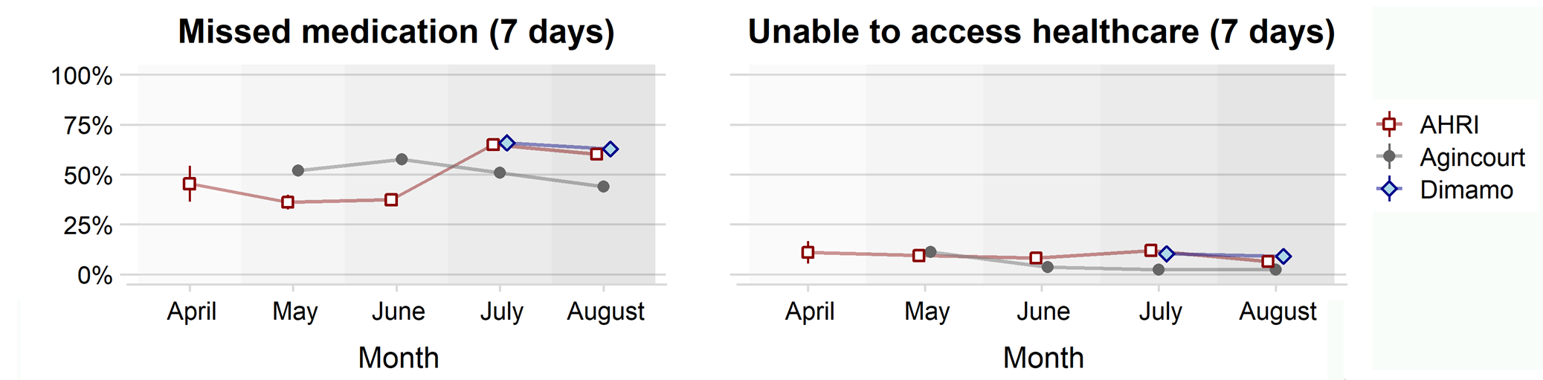
Self reported health service access
Guy Harling, Francesc Xavier Gómez-Olivé, …, Kobus Herbst. Protective behaviours and secondary harms from non-pharmaceutical interventions during the COVID-19 epidemic in South Africa: a multisite prospective cohort study. To be published.
Notes:
The next two graphs show how reported access to health care have changed, improving as lockdown levels decrease, but perhaps worsening as Covid-19 cases start to increase in KwaZulu-Natal.

Slide 6
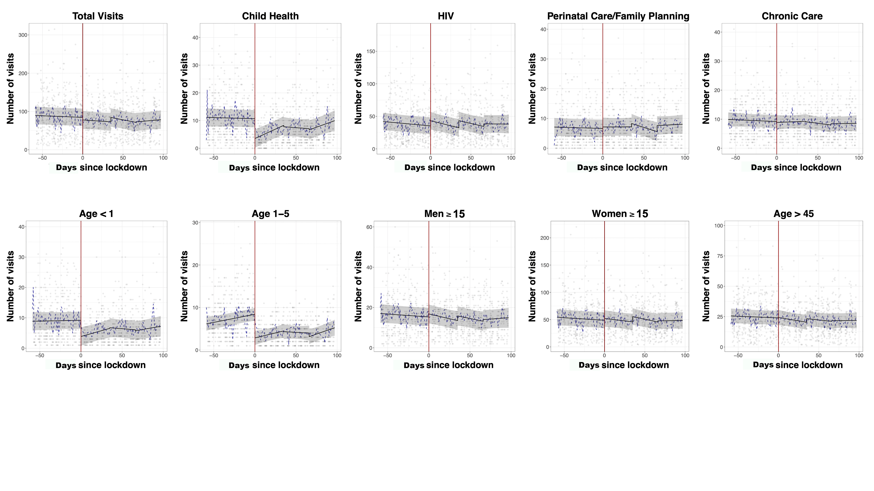
Ambulatory clinic visitation before and after the nationwide lockdown in South Africa – Hlabisa sub-district, KZN
Siedner MJ, Kraemer JD, …, Herbst K. Access to primary healthcare during lockdown measures for COVID-19 in rural South Africa: an interrupted time series analysis. BMJ open. 2020 Oct 1;10(10):e043763.
Notes:
The second set of graphs show what happened to clinic visits immediately around the imposition of level 5 lockdown on 26 March in the KwaZulu-Natal node, with child health visits declining, HIV visits increasing perhaps due to migrant workers returning to rural homes at the start of lockdown.

Slide 7
Laboratory Test Usage uMkhanyakude District KZN South Africa
Notes:
The third set of graphs looks at the number of laboratory tests done over the same months in 2018, 19 and 20 in the KZN uMkhanyakude district, showing a mixed picture with TB diagnostic test declining, but HIV related tests either staying the same or increasing.
The point I am making is that the picture is complex between community perceptions, and across actual health service measures, and careful analysis in well characterised populations such as SAPRIN is needed to learn lessons that are useful at a local district, provincial and national level.

Slide 8
Conclusions
Established longitudinal population cohorts can rapidly respond to a pandemic
Can look at health service delivery impact both from a population and health service perspective
Important to consider both population and health service perspective because they may differ
Population cohorts a resource to investigate the long term impact of Covid-19
Next focus for SAPRIN – vaccine hesitancy and perceptions

