Slide 1

Overview of Findings
NIDS-CRAM Wave 2
4 November 2020
Dr Nic Spaull
University of Stellenbosch
National income Dynamics Study (NIDS) Coronavirus Rapid Mobile Survey (CRAM)

Slide 2

BACKGROUND
NIDS-Wave 5 (2017)
  Existing panel study 2008-2017: The National Income Dynamics Study. NIDS is a panel study that began in 2008 as a nationally representative survey with the same individuals and their descendants being re-interviewed every 2-3 years between 2008 and 2017. It has been used in over 100 academic articles
NIDS-CRAM (2020)
  Wave 1: ~ 7000 individuals surveyed in NIDS-CRAM Wave 1: In total 17,568 randomly selected individuals from NIDS were called and of these, 7,073 were interviewed in NIDS-CRAM
  Wave 2: ~5700 responses (80% response rate – same individuals
  Details of the telephonic survey:
    Managed by SALDRU at UCT
    50 call centre agents phoning from 13 July to 13 August 2020
    20-minute survey (available in all 11 languages)
    R20 airtime given to respondents to thank them for participation.
    Questions on demographics, migration, grant-receipt, employment, income, hunger + COVID-19 risk perceptions and behaviour + (W2) education, ECD, mental health
  Wave 3-5 (Oct 2020 – July 2021) – includes sample top-up

Slide 3



BACKGROUND
Who funded NIDS-CRAM?
  The Allan & Gill Gray Philanthropy, the FEM Education Foundation, the Michael & Susan Dell Foundation
Who will have access to the data?
  All NIDS-CRAM data is immediately made freely available to the public and other researchers on the DataFirst platform. W2 data is now up. We encourage others to analyze the data for their own purposes and to replicate our results (we have also posted our do files so people can replicate our analysis.

Slide 4
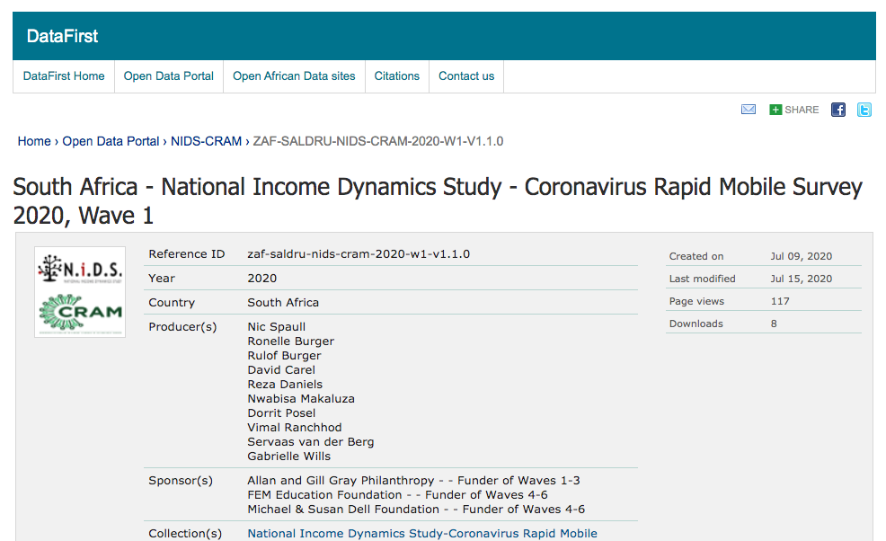

Slide 5








(2) Researchers & SteerCo

Slide 6
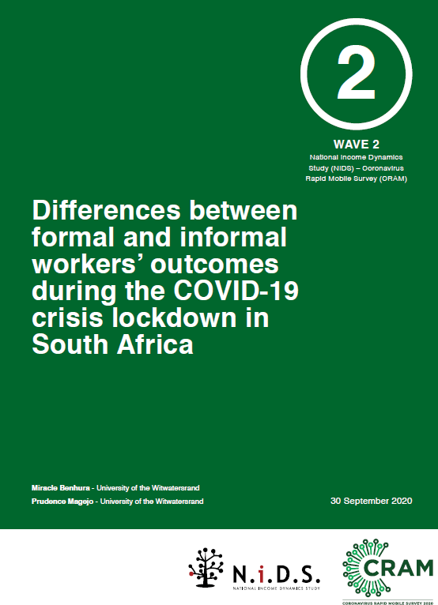
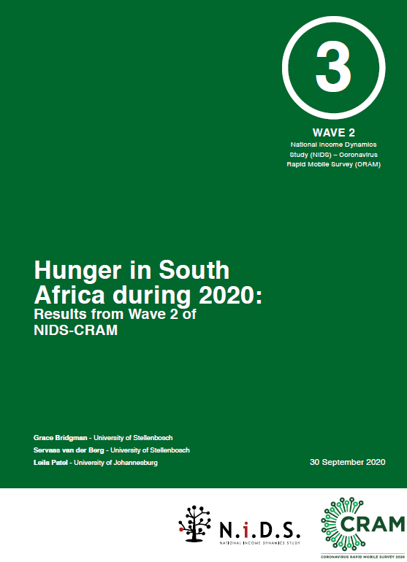
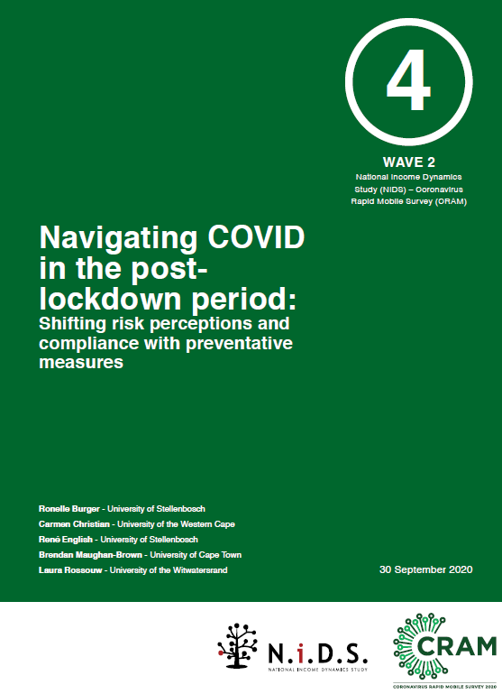
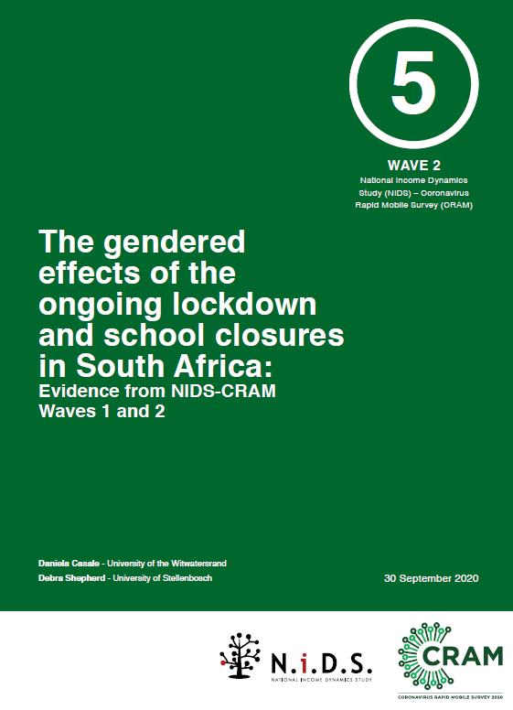
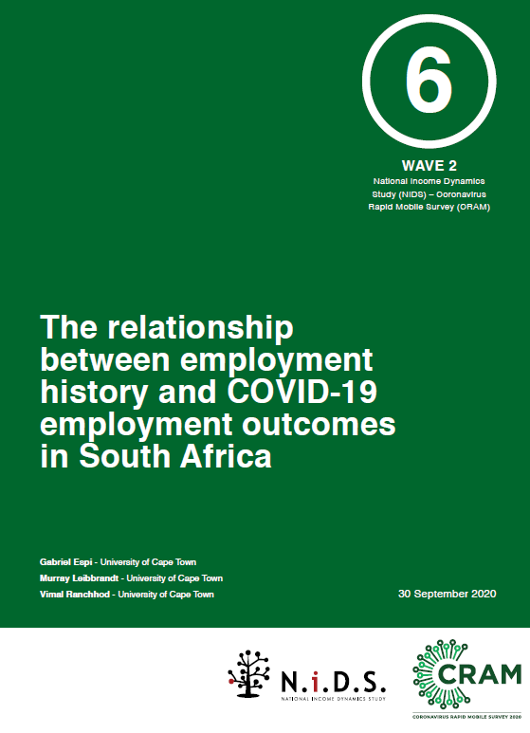
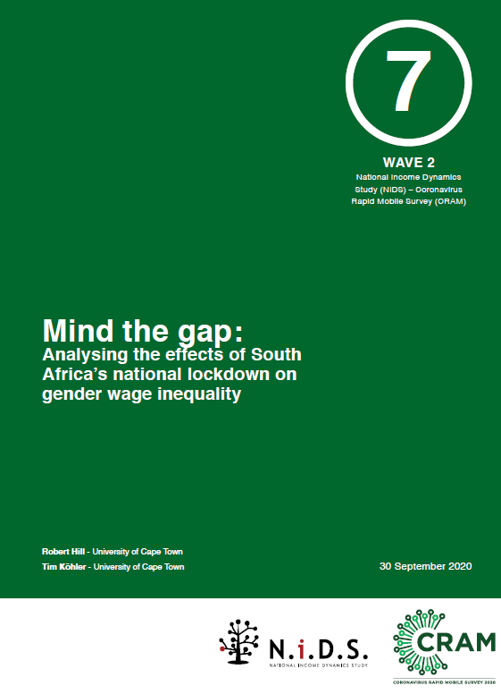
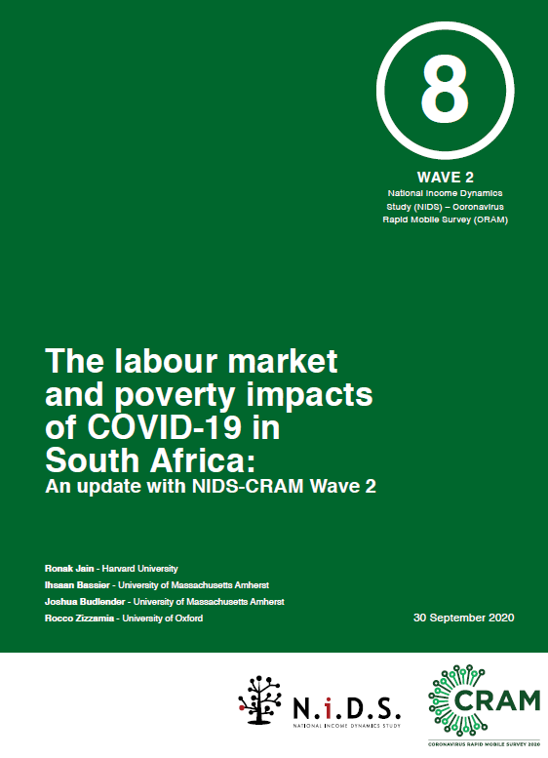
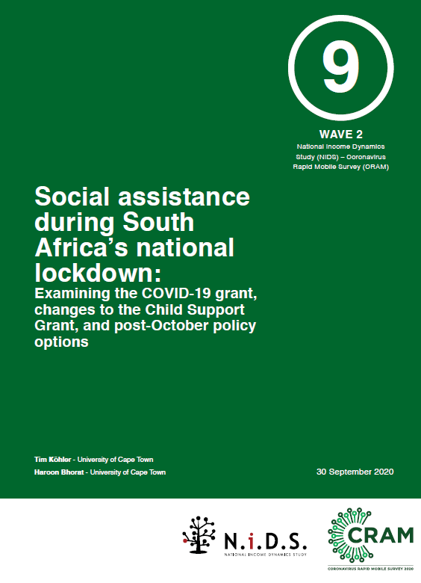
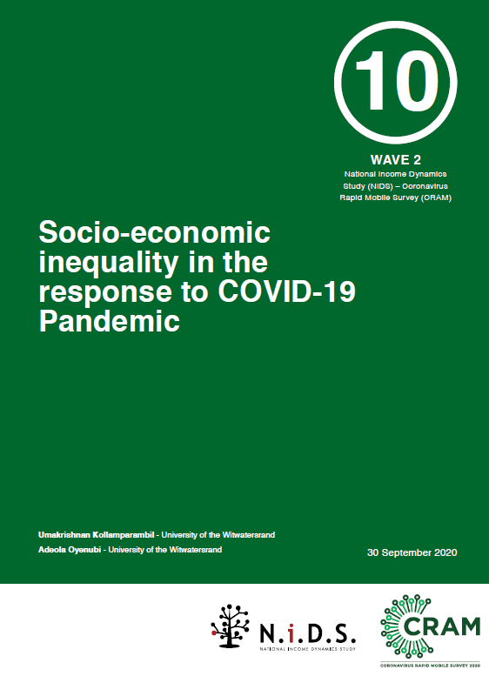
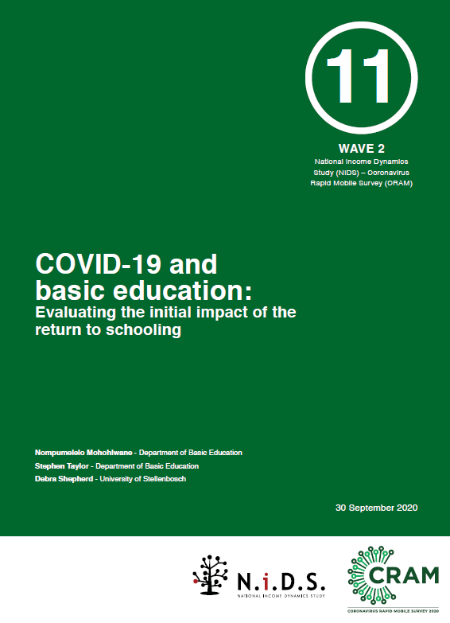
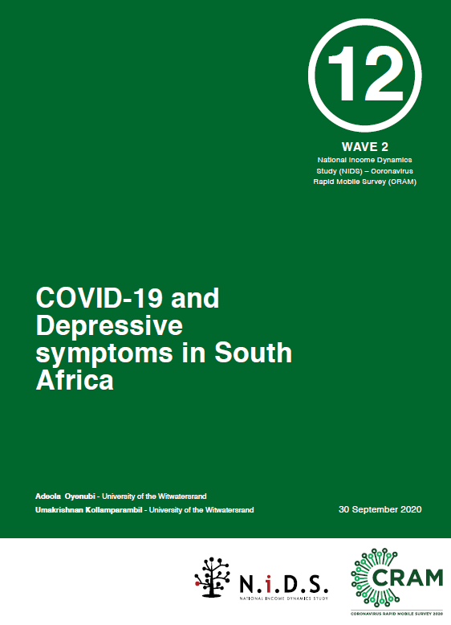
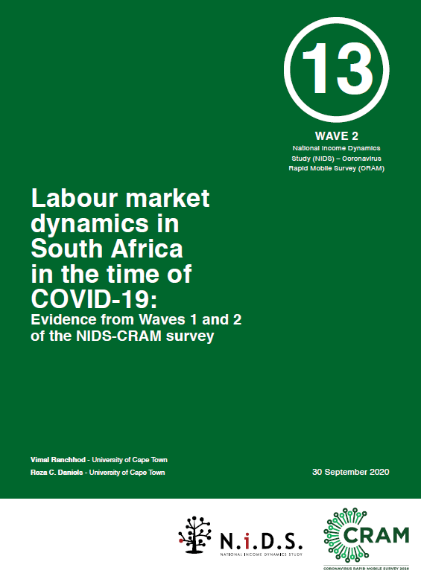
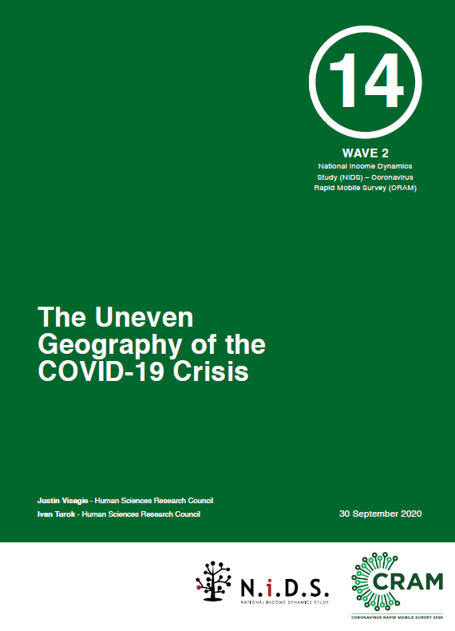
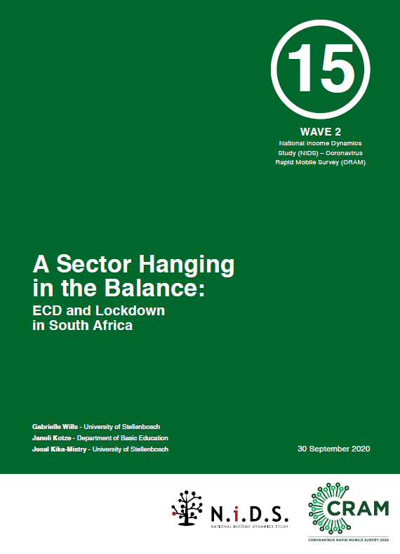
Wave 2: 15 papers
https://cramsurvey.org/reports/

Slide 7




Wave 2: Technical reports

Slide 8
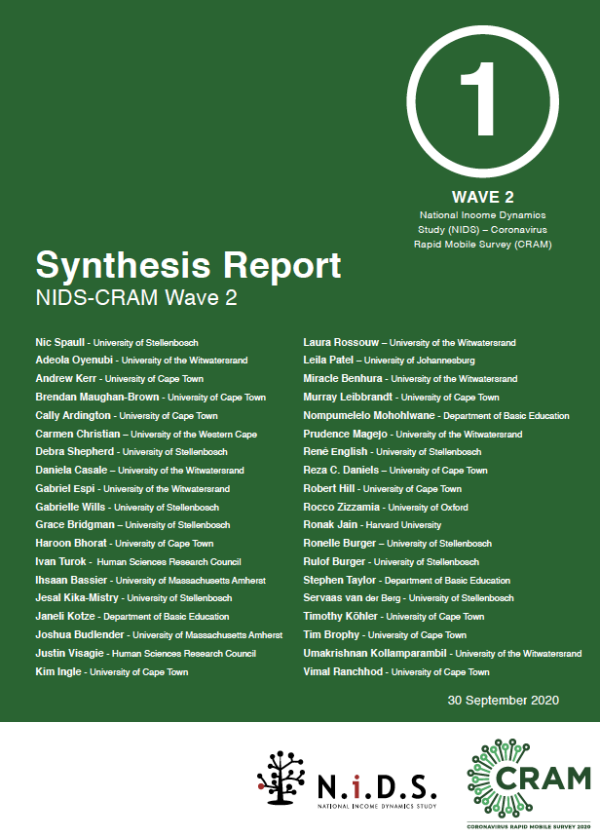
Findings
What are the main findings from Wave 2?

Slide 9
Sobering results, first caveats
  Some limitations to telephonic surveys: There are limitations to surveying respondents telephonically, including length of the survey (20min), comparability to in-person survey results etc.
  NIDS-2017 slightly higher employment than QLFS: The respondents in NIDS-2017 had a higher rate of employment compared to other surveys like the QLFS
      54% in NIDS 2017 (18-64 years).
      47% in QLFS 2017 (18-64 years).
  Results do reflect underlying employment an welfare dynamics in SA: Notwithstanding these caveats, we believe that researchers and policy-makers can feel confident that the results from NIDS-CRAM are broadly representative and are speaking to the real underlying labour market and welfare dynamics in South Africa at this time.
  “Taken as a whole, the general results are supportive of the NIDS-CRAM data being valid and not subject to major non-response bias” (Ardington, 2020).

Slide 10
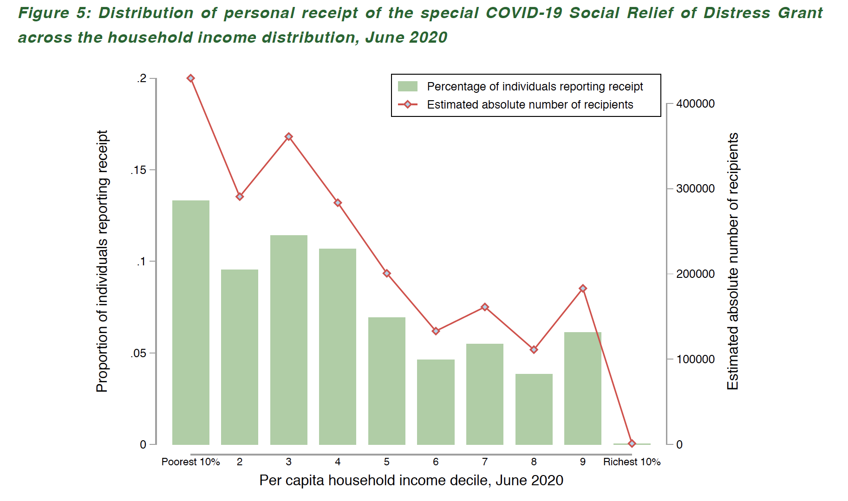
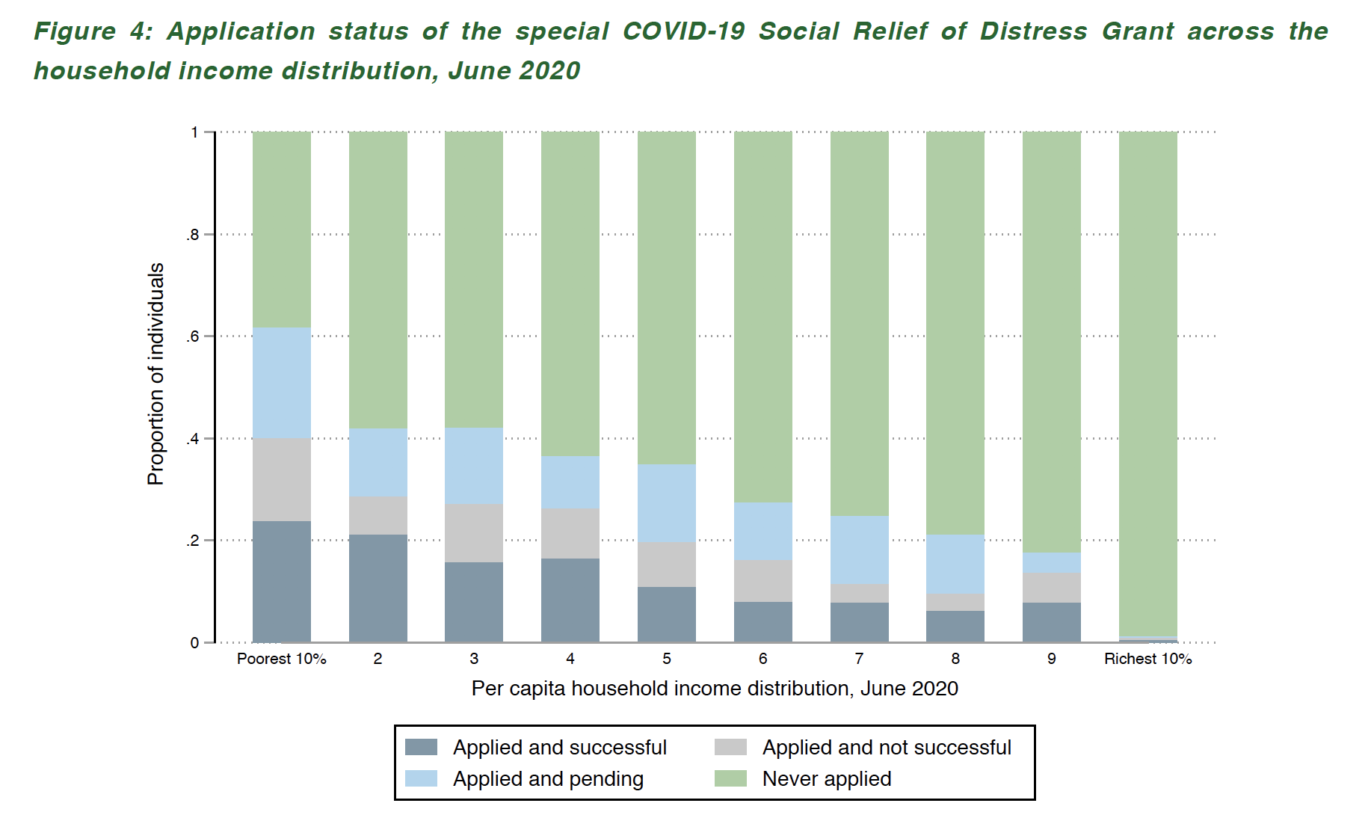
1. Grants
COV-19 SRD Grant
  Brought millions of previously unreached individuals into the system.
  Application for and receipt have been relatively pro-poor.
  ~4,3-million recipients by July/Aug (SASSA reports 4,4mil)
Source for both: Kohler & Bhorat, 2020

Slide 12

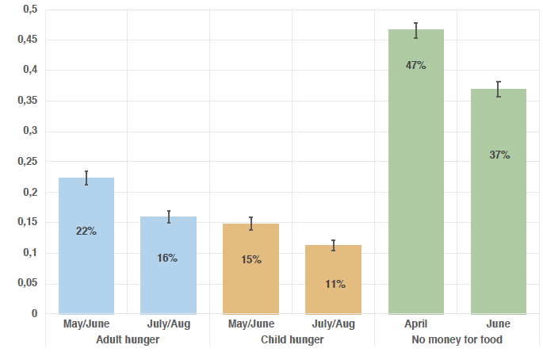
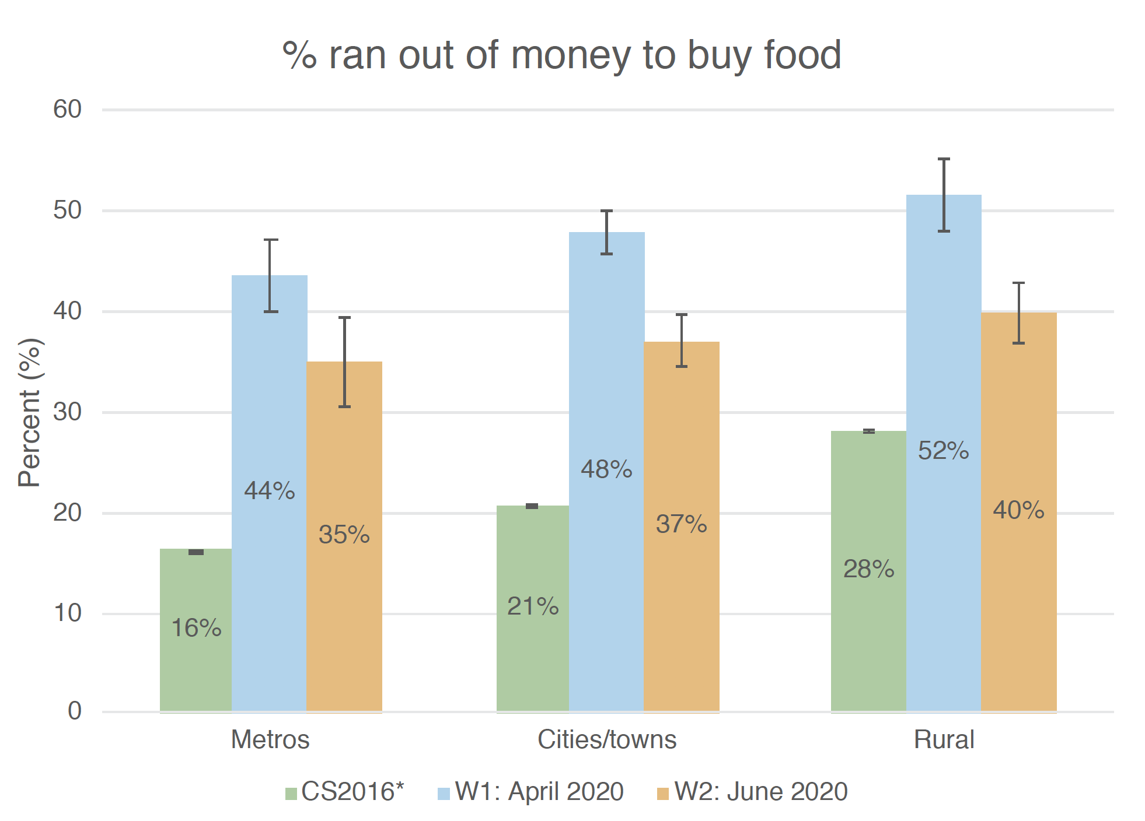
2. Hunger
27% decline in child & HH hunger April→June 2020
  Due to grants, UIF/TERS, previously furloughed workers
  Monthly figures still 2x annual figures from 2016 (Community Survey)
Source: Bridgman et al (2020)
Source: Visagie & Turok (2020)

Slide 13
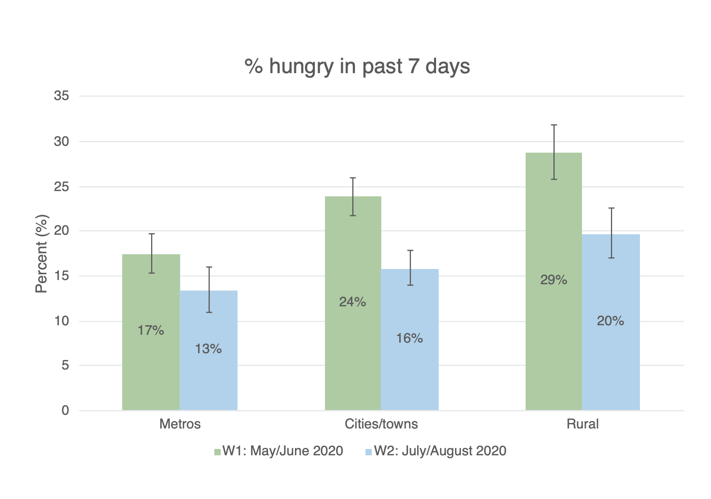
2. Hunger

Slide 14
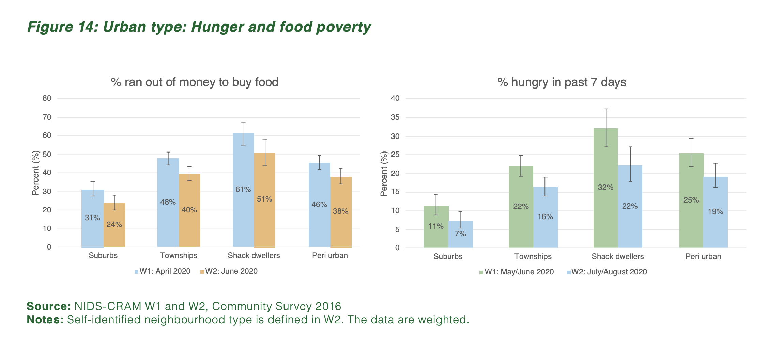
2. Hunger

Slide 15
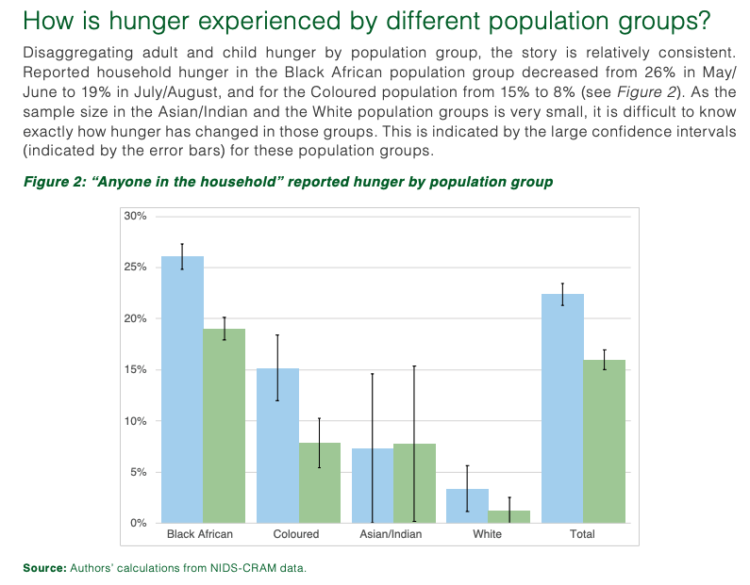
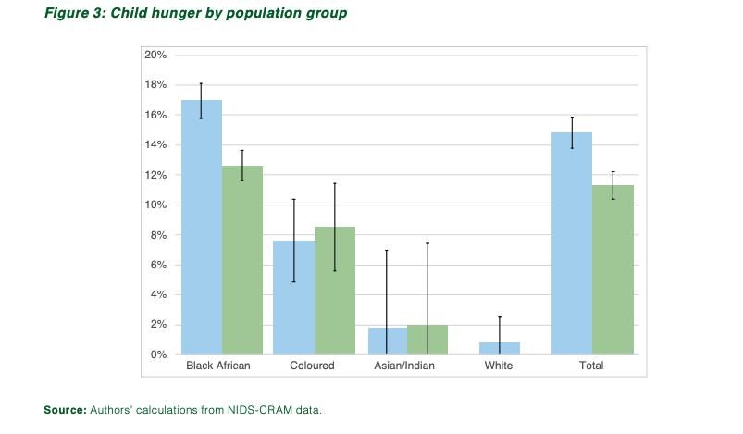

Slide 16
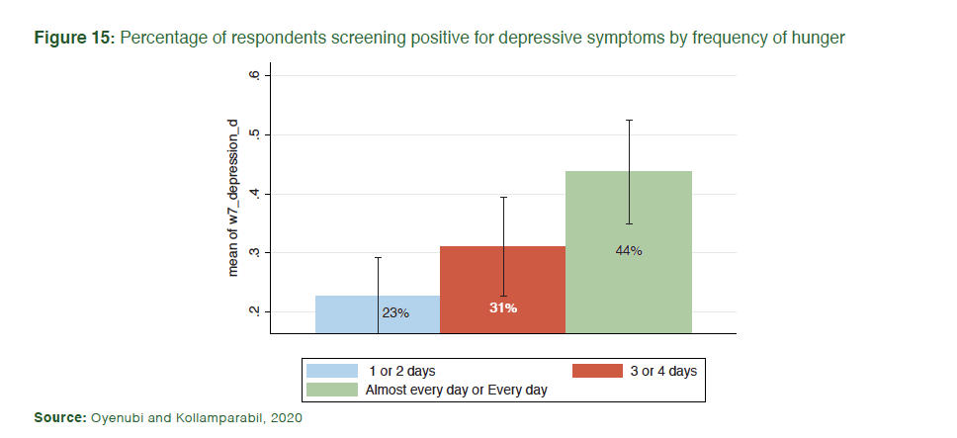

3. Mental health
The prevalence of depressive symptoms seems to have doubled between 2017 and June 2020 (COVID-19 era), from 12% to 24% of individuals. Using their cut-off for depressive symptoms, Oyenubi & Kollamparabil (2020) find that while 12% of South Africans screened positive for depressive symptoms in NIDS 2017, when those same individuals were resurveyed in NIDS-CRAM Wave 2 (June/July 2020) this had increased to 24%. (Note ‘depressive symptoms’ are not the same as ‘depression’ – the latter is a medical diagnosis).
Those reporting extreme hunger (hunger ‘Every day’ or ‘Almost every day’) were twice as likely to screen positive for depressive symptoms. In addition to experiencing any hunger, those respondents reported perpetual hunger (‘Every day’ or ‘Almost every day’) had twice the prevalence of depressive symptoms (44%) compared to those who experienced hunger 1-2 days a week or not at all (about 23%).

Slide 17
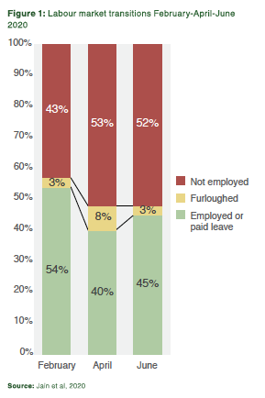
4. Employment
Jobs: 2.8-million jobs lost between February and April have not returned by June (StatsSA QLFS Q2= 2.2-mil jobs lost)
Furlough: The # of furloughed workers has returned to pre-COVID levels with half of furloughed workers being ‘re-employed’ and about 40% becoming unemployed

Slide 18
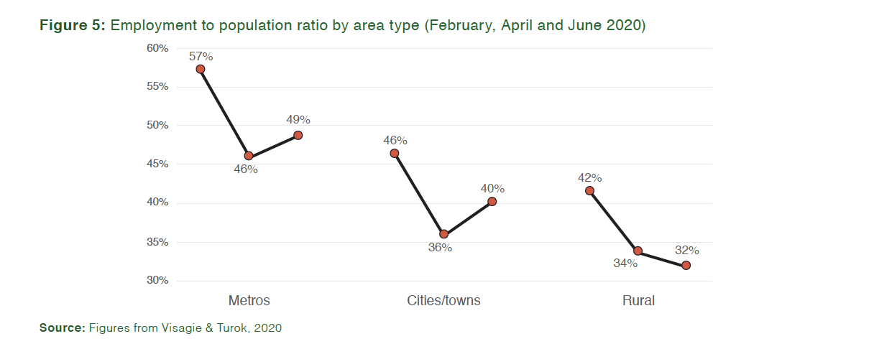
2. Location
Rural areas have been more affected by job losses than urban areas.

Slide 19
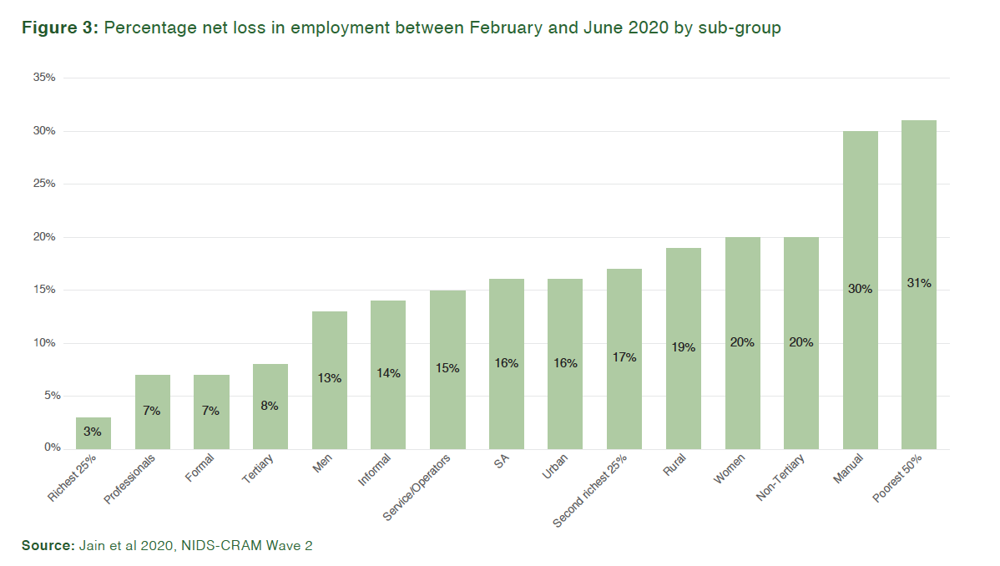
Employment
From February to June 2020 workers who were poor, rural, female, unskilled and less educated have experienced the largest declines in employment. The poorest 50% of workers and manual laborer’s were ten times more likely (31% net loss) to lose their job between February and June compared to the richest 25% of workers (3% net loss). Informal workers were twice as likely to lose their jobs (14%) compared to formal sector workers (7%).

Slide 20
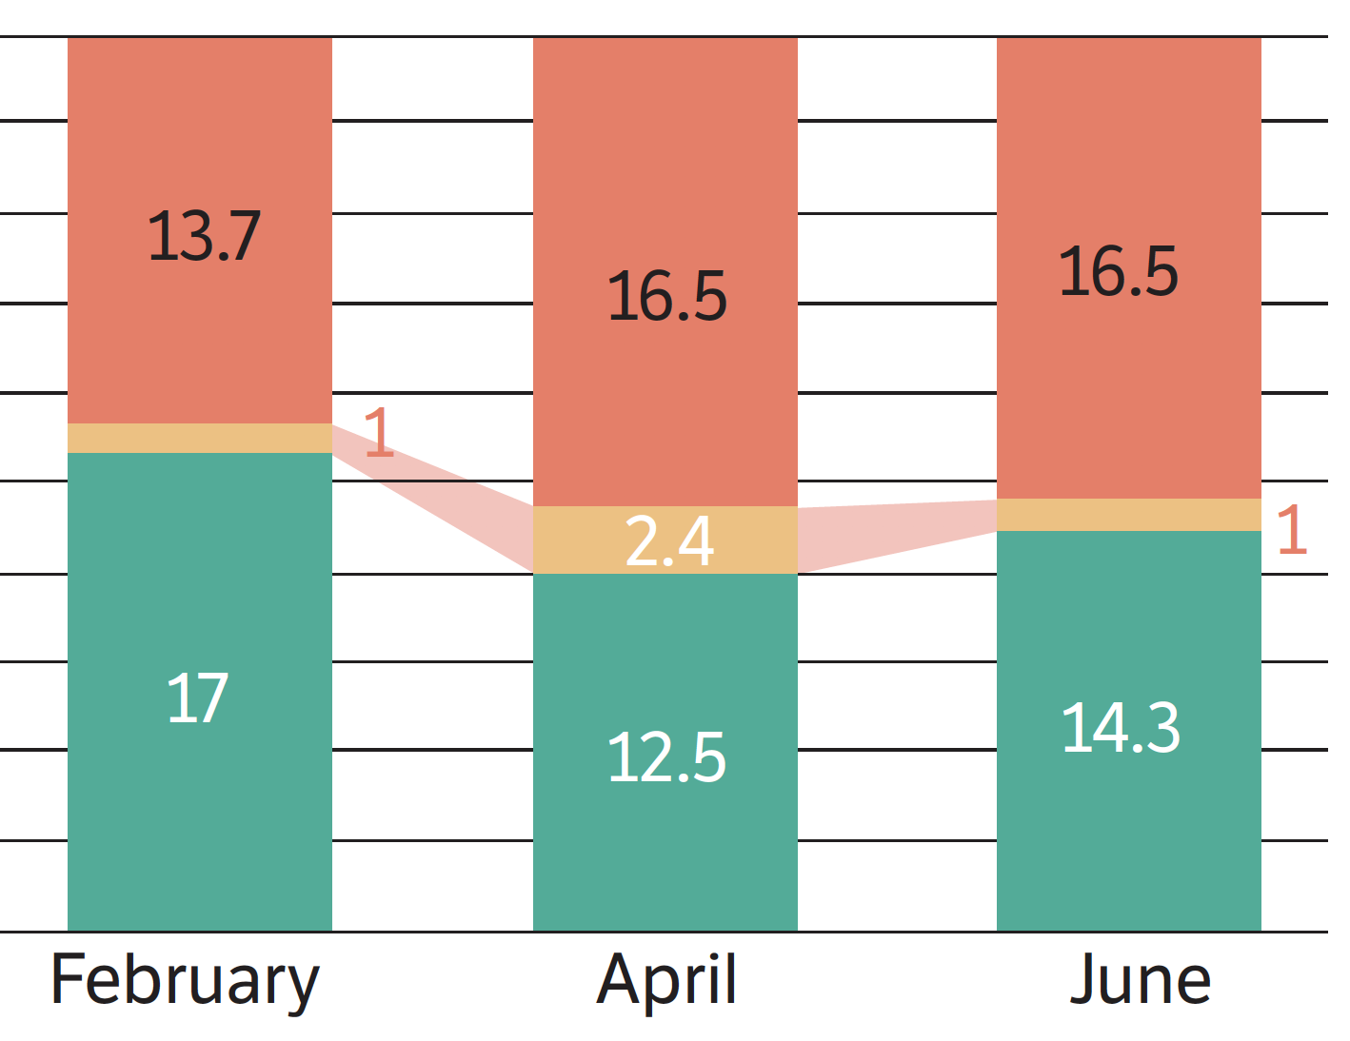

Using NIDS-CRAM weights…
(-2.2-million jobs lost Q1→Q2 2020 StatsSA QLFS)
-2.8-million jobs lost Feb→June 2020
(millions)

Slide 21


“There are decades where nothing happens and weeks where decades happen.”
- Lenin

Slide 22
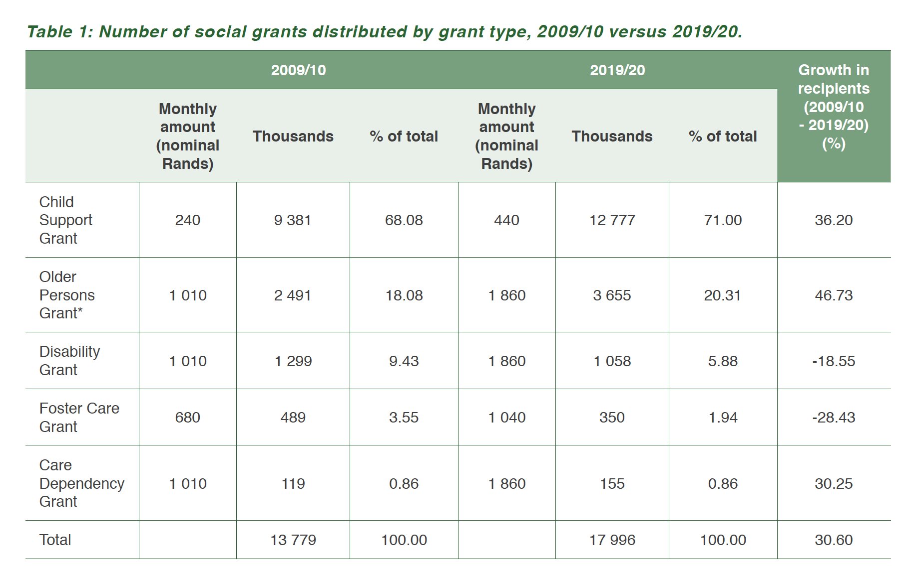
A decade’s worth of grant-growth accomplished in 6-months?
10 years: Between 2009 and 2019 the total number of grants paid out in SA grew from 14mil to 18mil (+4mil) (Kohler & Bhorat 2020)
4 months: By July/August 4,2-mil people had received COV-19 SRD grants. (SASSA reports 4,3mil recipients)
…grants
+4mil
Source: Kohler & Bhorat, 2020

Slide 23
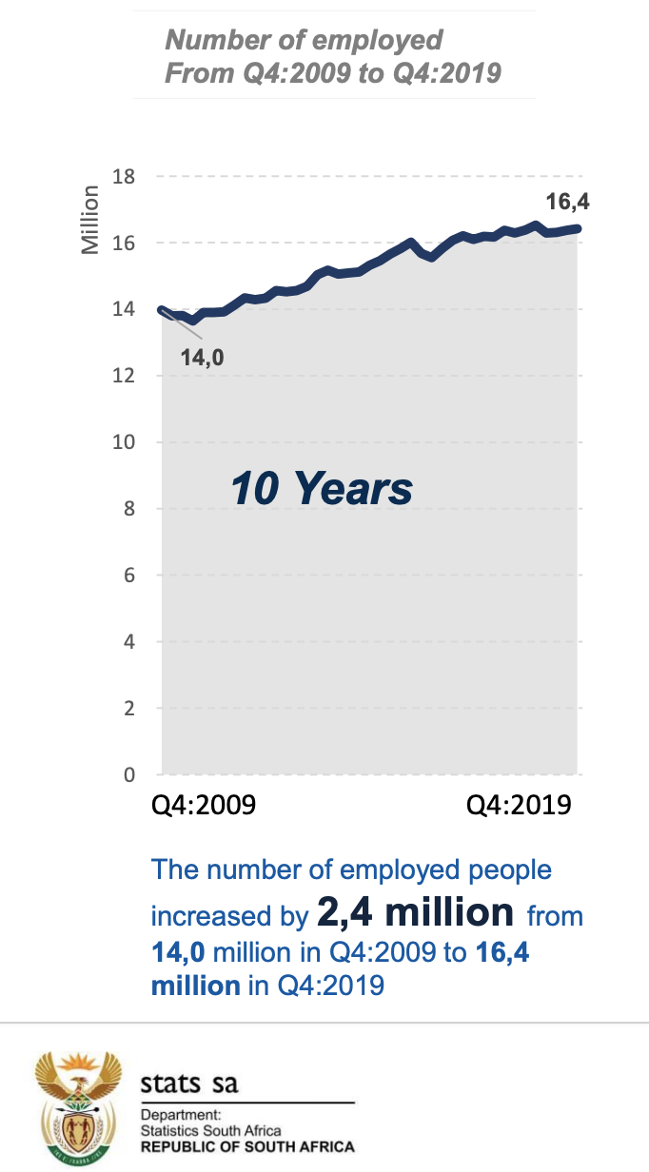
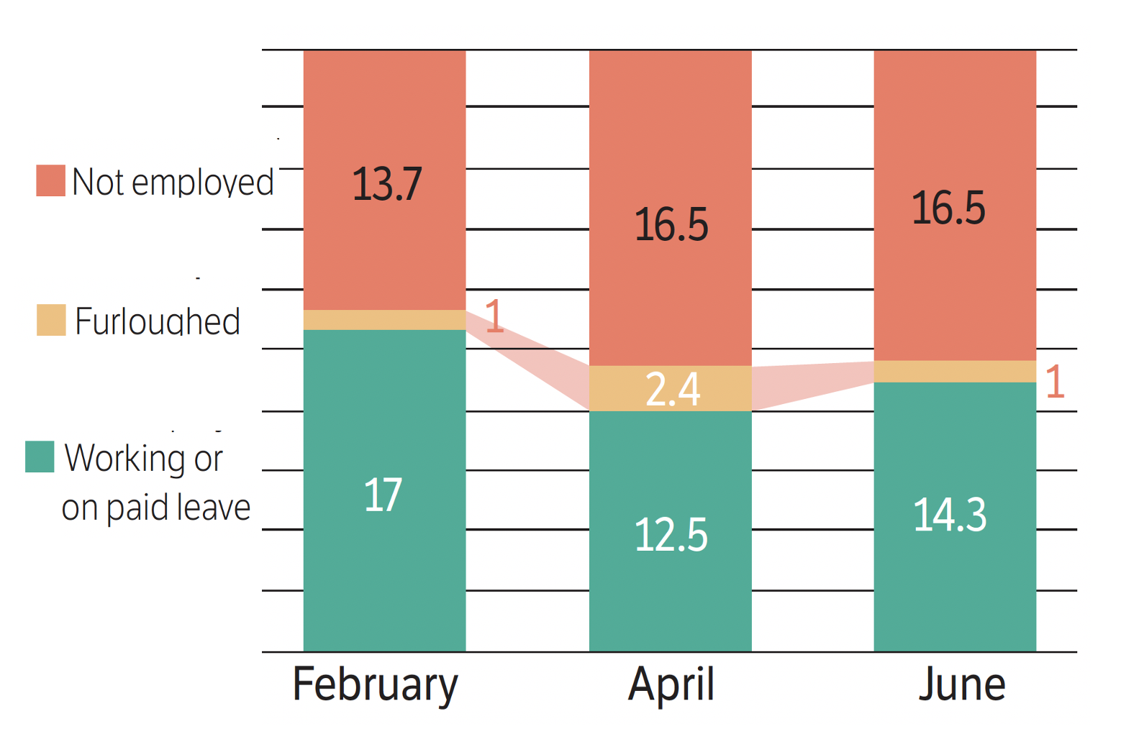
A decade’s worth of job-growth lost in 6-months?
NIDS-CRAM 2020
-2.8-million net jobs lost Feb→June 2020
QLFS 2020:
-2.2-million net jobs lost Q1→Q2
Weighted NIDS-CRAM Wave 1+2 (millions)
…jobs
Notes:
http://www.statssa.gov.za/publications/P0211/Presentation%20QLFS%20Q4_2019.pdf

Slide 24
Wave 2: 15 papers
https://cramsurvey.org/reports/

Slide 25
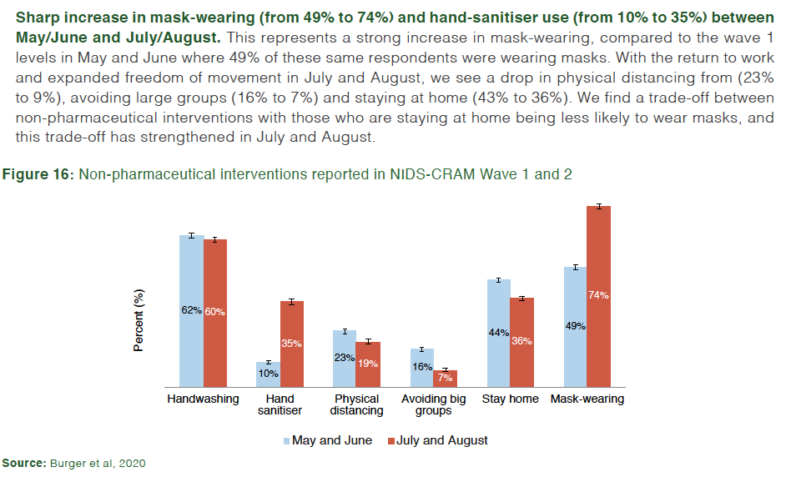
3. Health

Slide 26
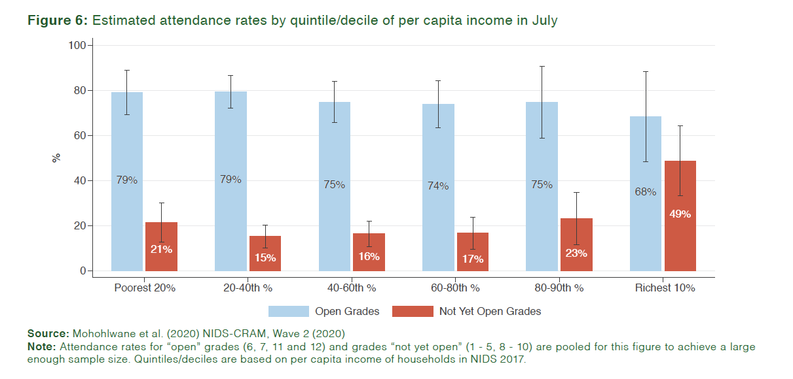
3. Education
Increasing educational inequality during lockdown

Slide 27
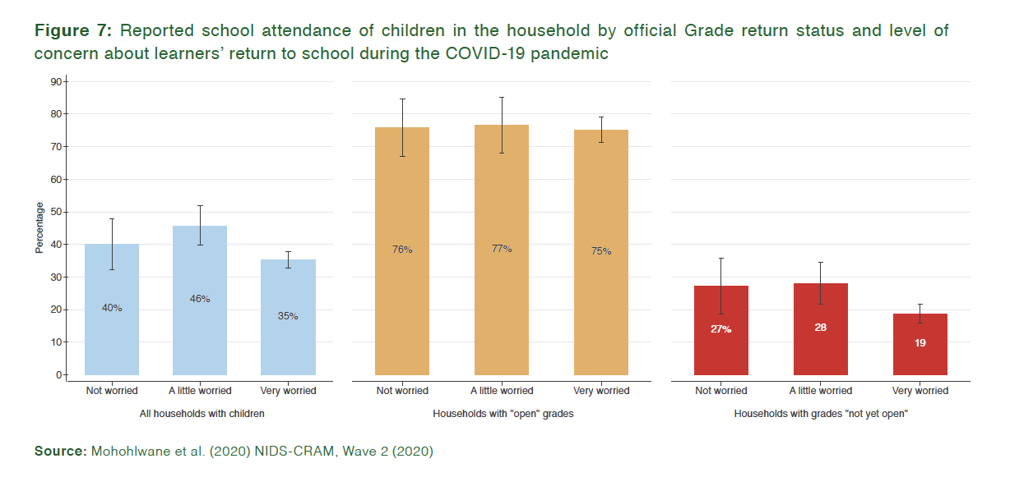
3. Education
Parents sent their children back to school irrespective of their reported rates of worry:

Slide 28
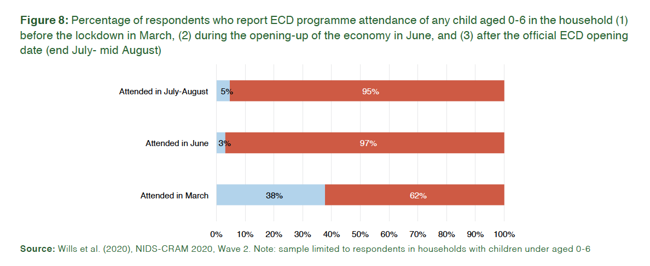
4. ECD
The Early Childhood Development (ECD) sector was operating at just a quarter of its pre-crisis levels a month after programmes could reopen. Only 13% of children aged 0-6 were attending ECD programmes by mid-July to mid-August compared to 47% in 2018.

